Slide 1
CIRCUIT AND SYSTEMS
COURSE CODE: ETEE-207
By
Mr. LALIT AGARWAL
ASSISTANT PROFESSOR
EEE, MAIT

Slide 2
LECTURE-4 & 5

Slide 3
OTHER BASIC SIGNALS
EXPONENTIAL SIGNAL:
Exponential signal f(t) is expressed as:
f(t) = 0 ; t < 0
Ke^{-at} ; t ≥ 0
(where a and K are real constants)
The inverse of a has the dimension of time and is called as the time constant(T).
T = 1/a
Time period is the time taken to reach 63.2 % of the total change from initial value to final value.

Slide 4
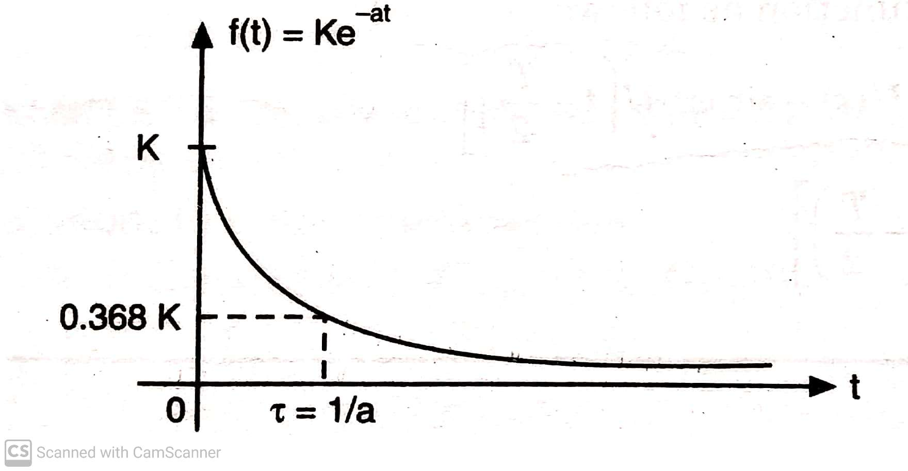

Slide 5
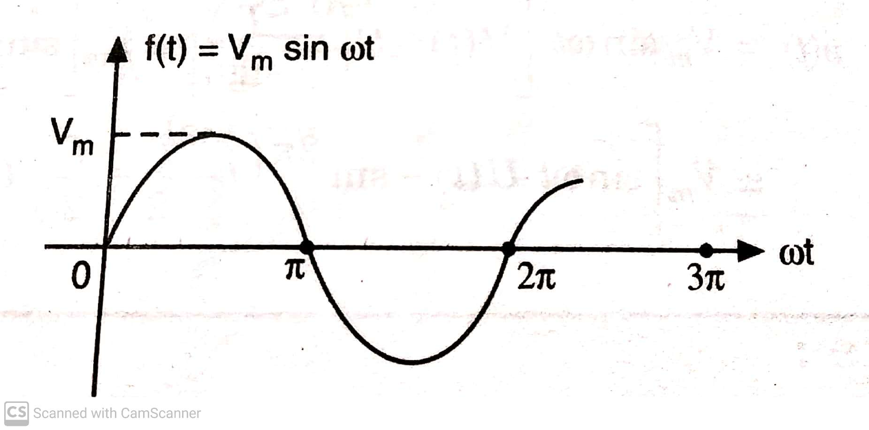
SINUSOIDAL SIGNAL:
Sinusoidal signal f(t) is expressed as:
f(t) = 0 ; t <0
Vm sin ωt ; t ≥ 0
Where Vm is peak amplitude and ω is angular frequency in rad/sec.

Slide 6
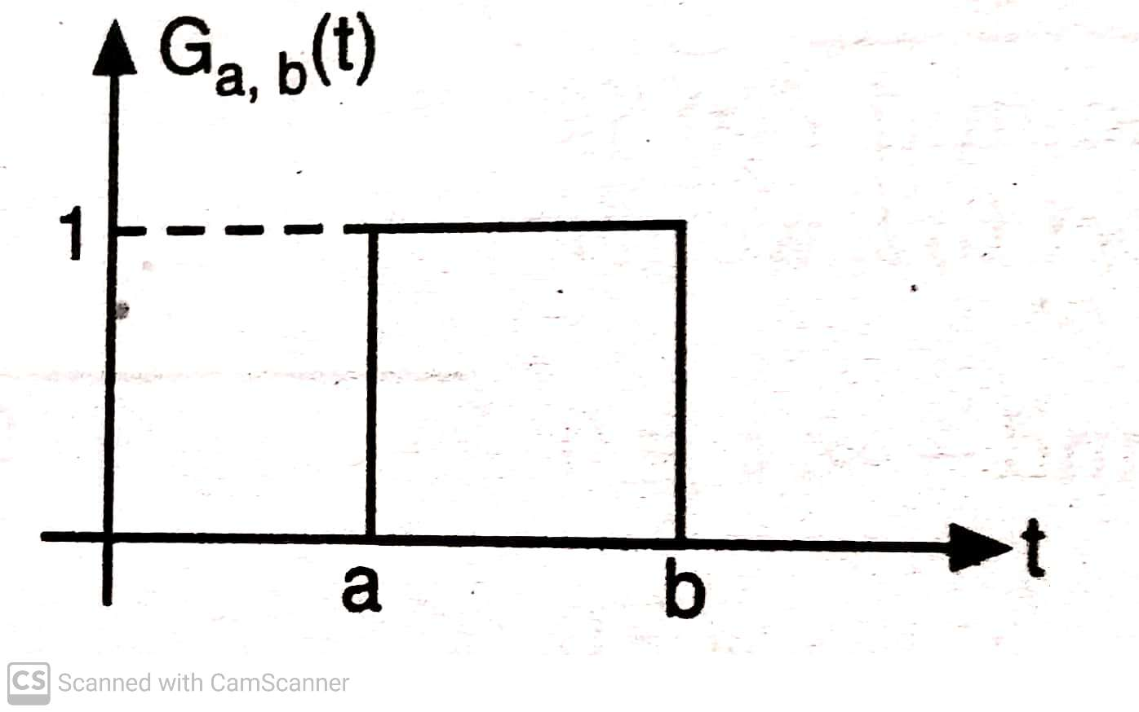
GATE SIGNAL (FUNCTION)
A rectangular pulse of unit height (i.e. unity amplitude) , starting at t = a and ending at t = b is called as a gate function and it is represented as:
G a, b (t) = U(t-a) – U(t-b)

Slide 7
WAVEFORM SYNTHESIZATION

Slide 8
NUMERICALS
Q1) Draw the waveforms of the functions given below:
f(t)
f(t) U(t)
f (t-t₀)
f (t-t₀) U(t)
f(t) U(t-t₀)
f (t-t₀) U(t-t₀)
where f(t) = sin ωt

Slide 9
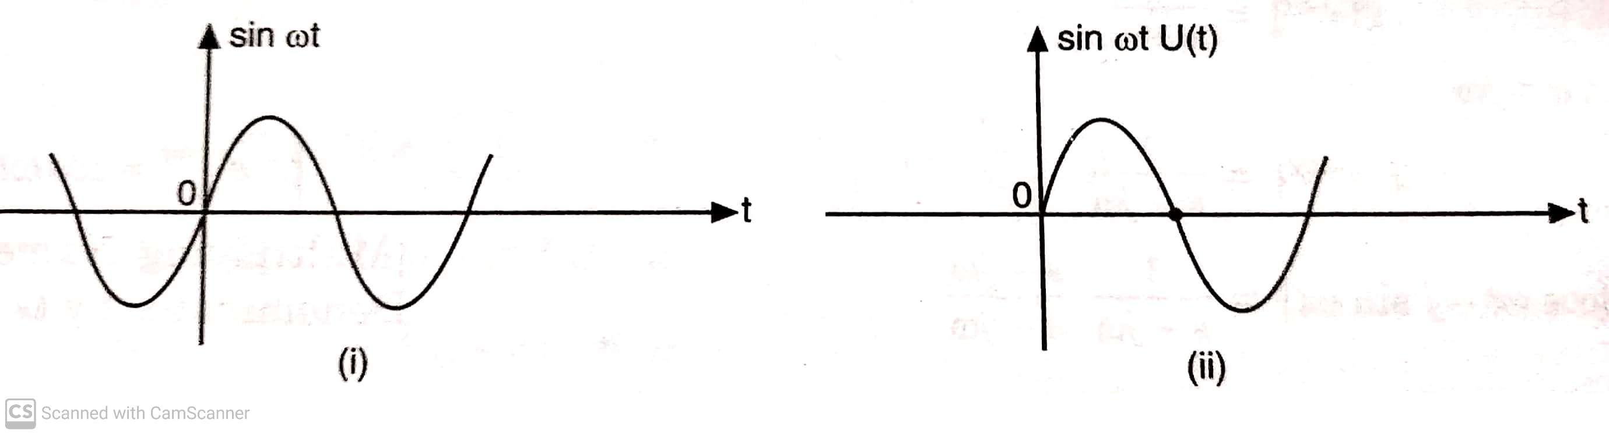
SOLUTION(1)
(i) & (ii)

Slide 10
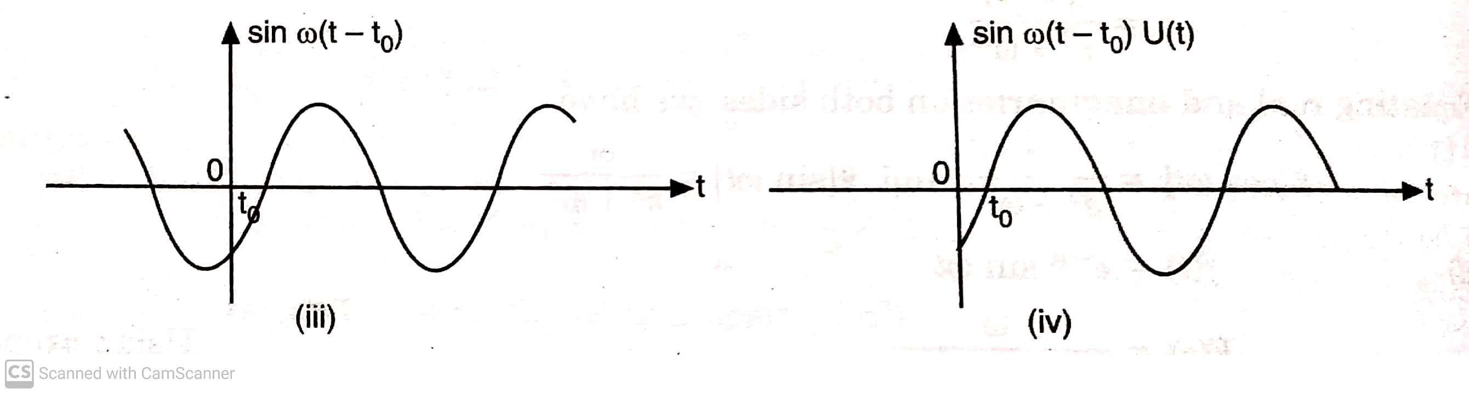
(iii) & (iv)

Slide 11
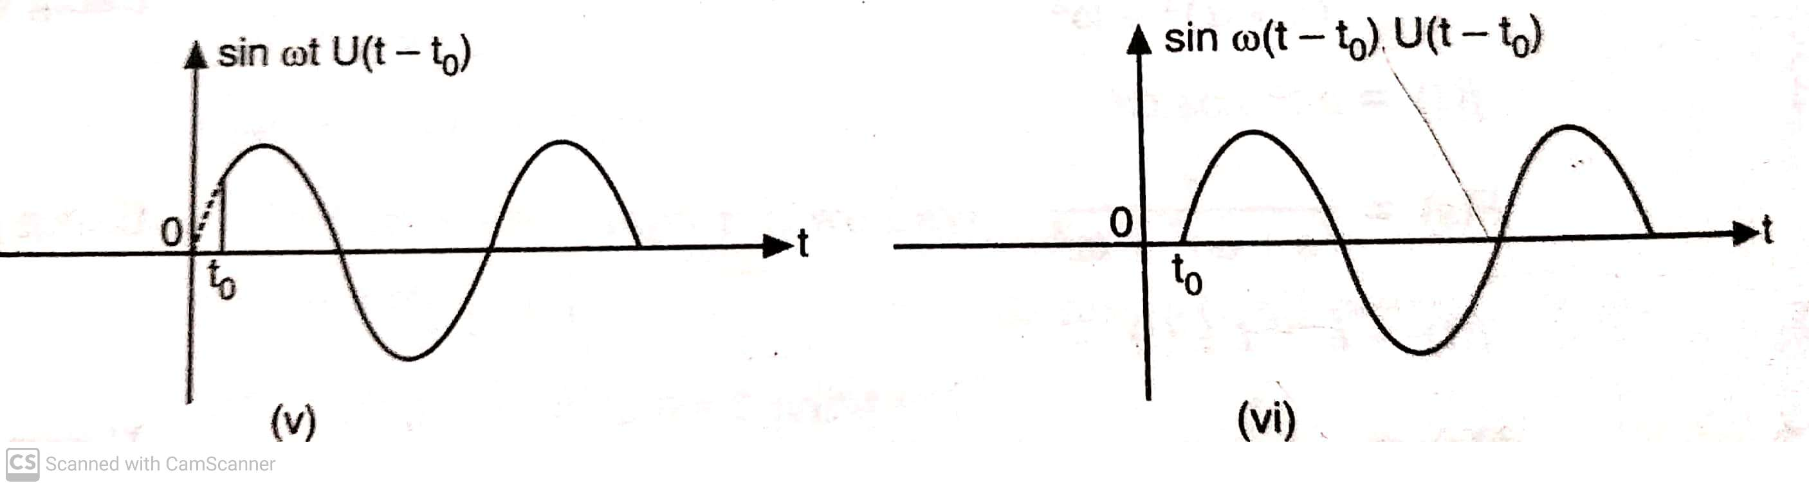
(v) & (vi)

Slide 12
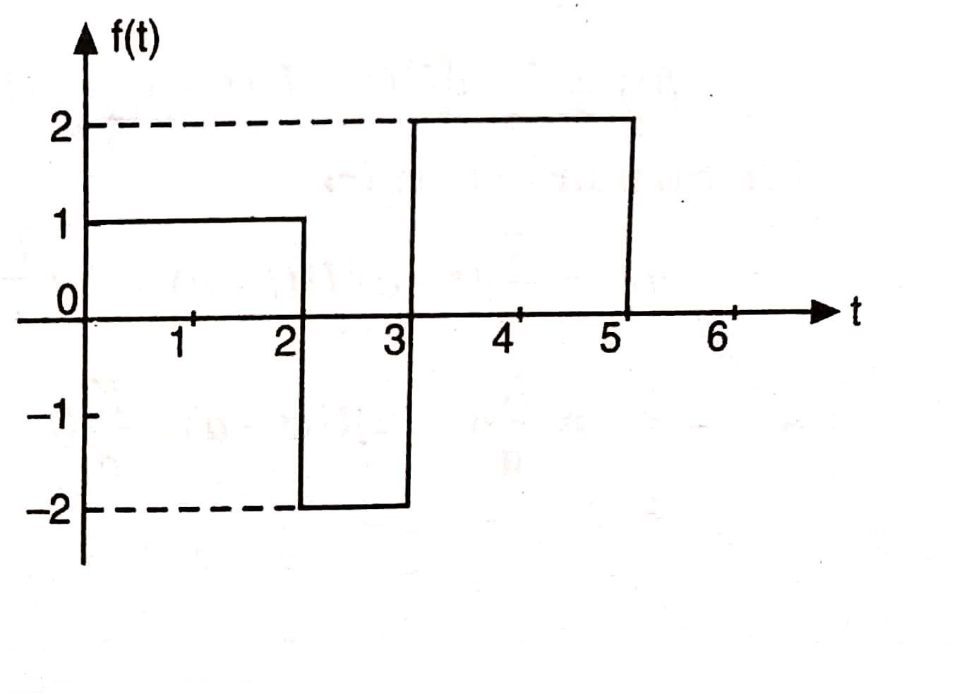
Q 2) Synthesize the given waveform shown in figure below:

Slide 13
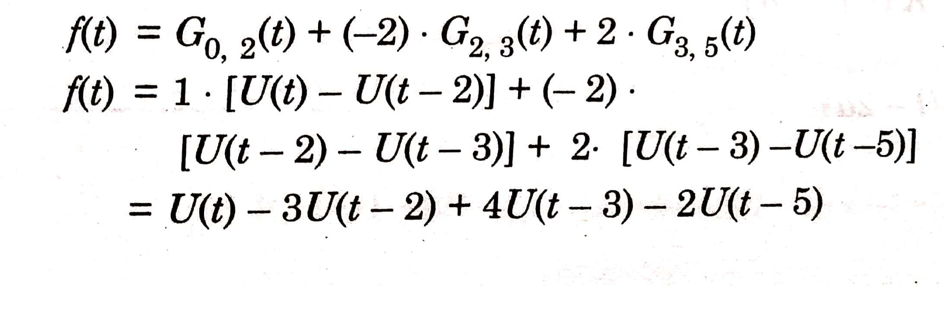
SOLUTION (2)

Slide 14
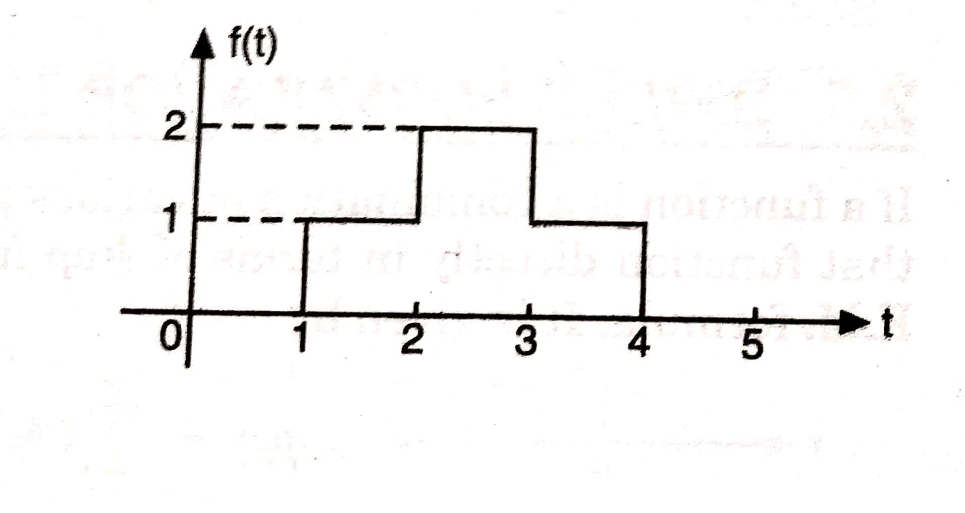
Q 3) Synthesize the given waveform shown in figure below:

Slide 15
SOLUTION(3)
Using GATE function the given waveform can be synthesized as:
f(t) = G_{1,2}(t) + 2* G_{2,3}(t) + G_{3,4}(t)
= 1* [ U(t-1) - U(t-2) ] + 2* [ U(t-2) – U(t-3) ]
+ 1* [ U(t-3)- U(t-4) ]
= U(t-1) + U(t-2) – U(t-3) – U(t-4)

Slide 16
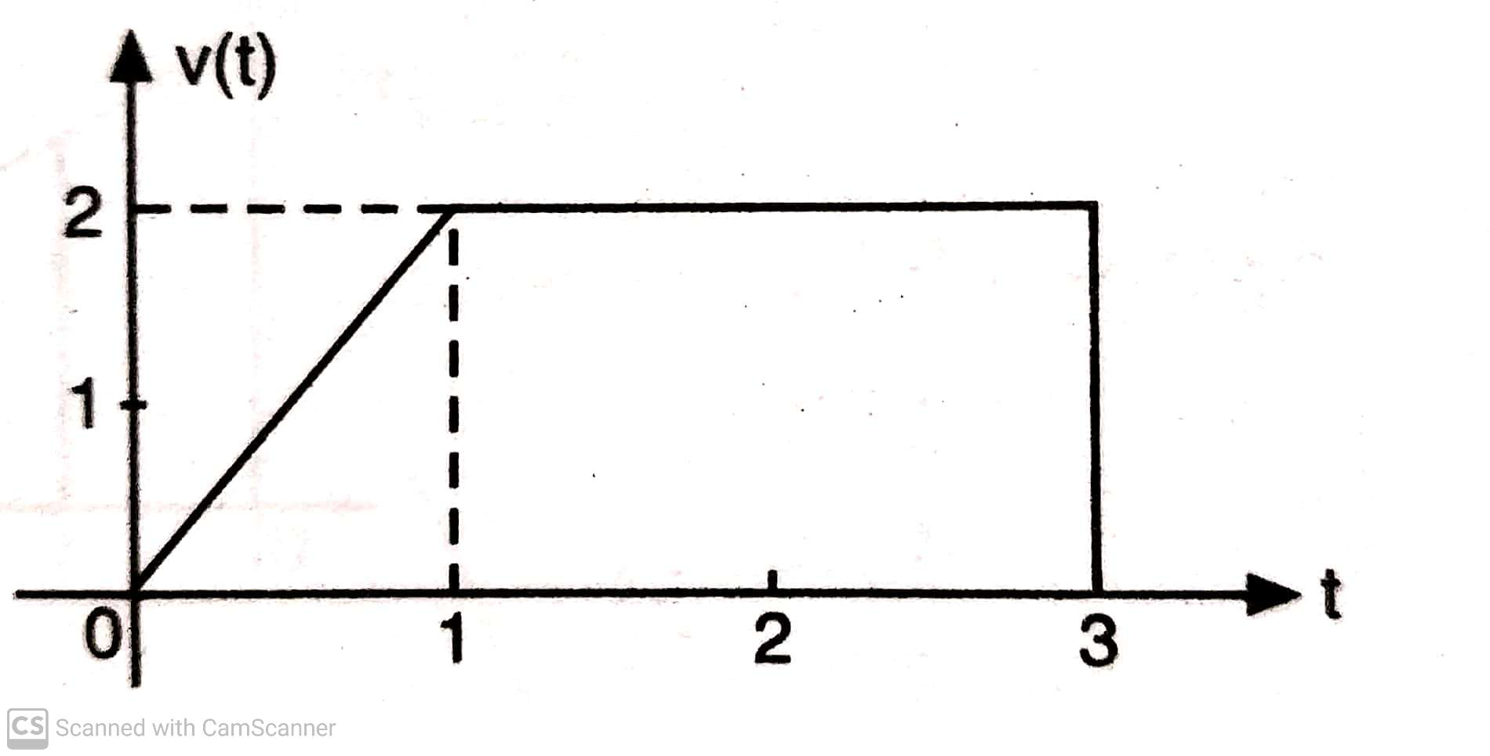
Q 4) Synthesize the given waveform shown in figure below:

Slide 17
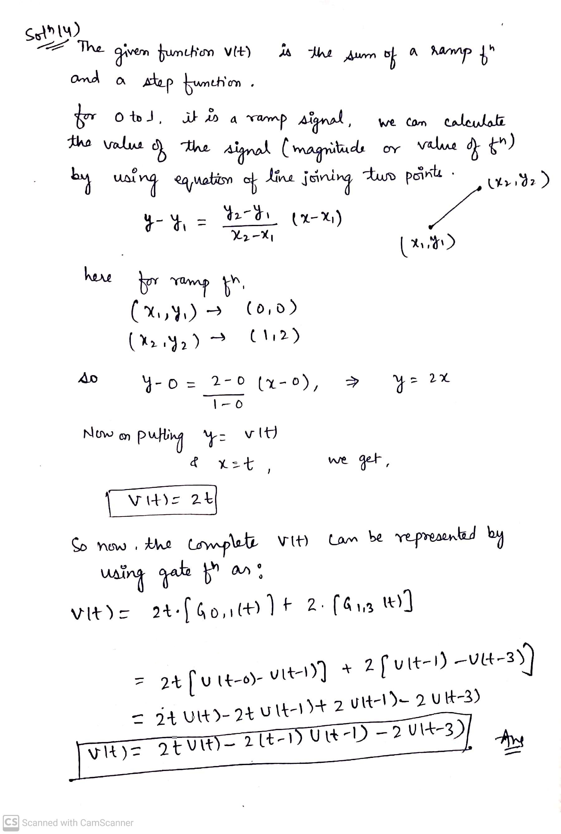

Slide 18
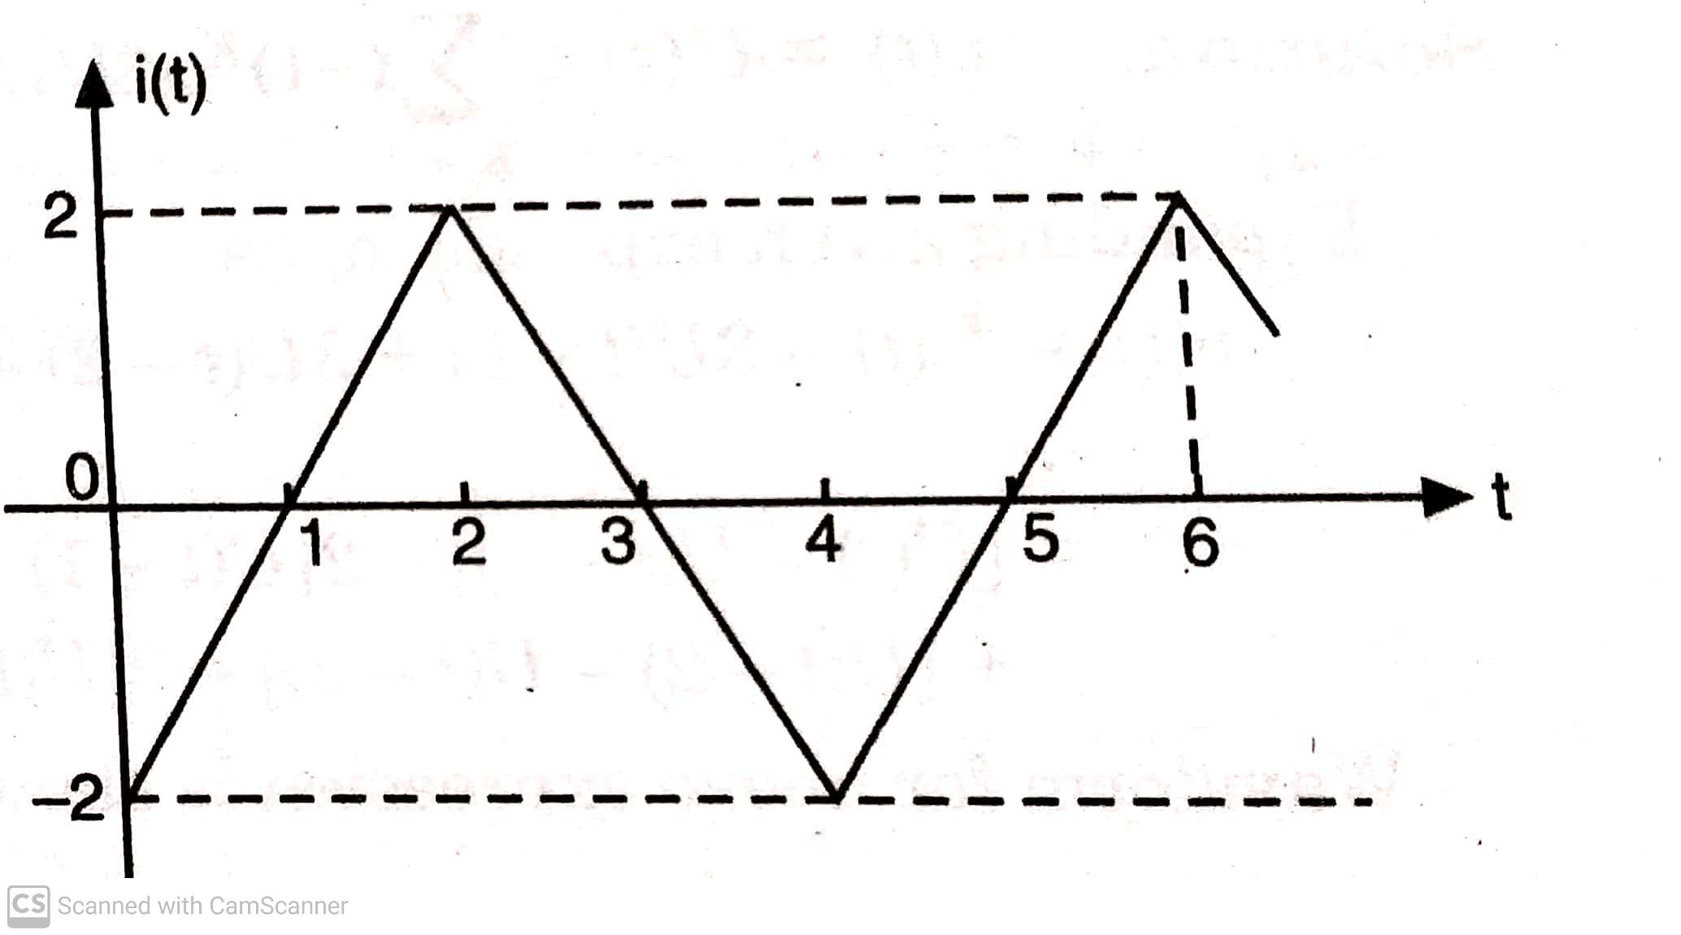
Q 5) Synthesize the given waveform shown in figure below:

Slide 19
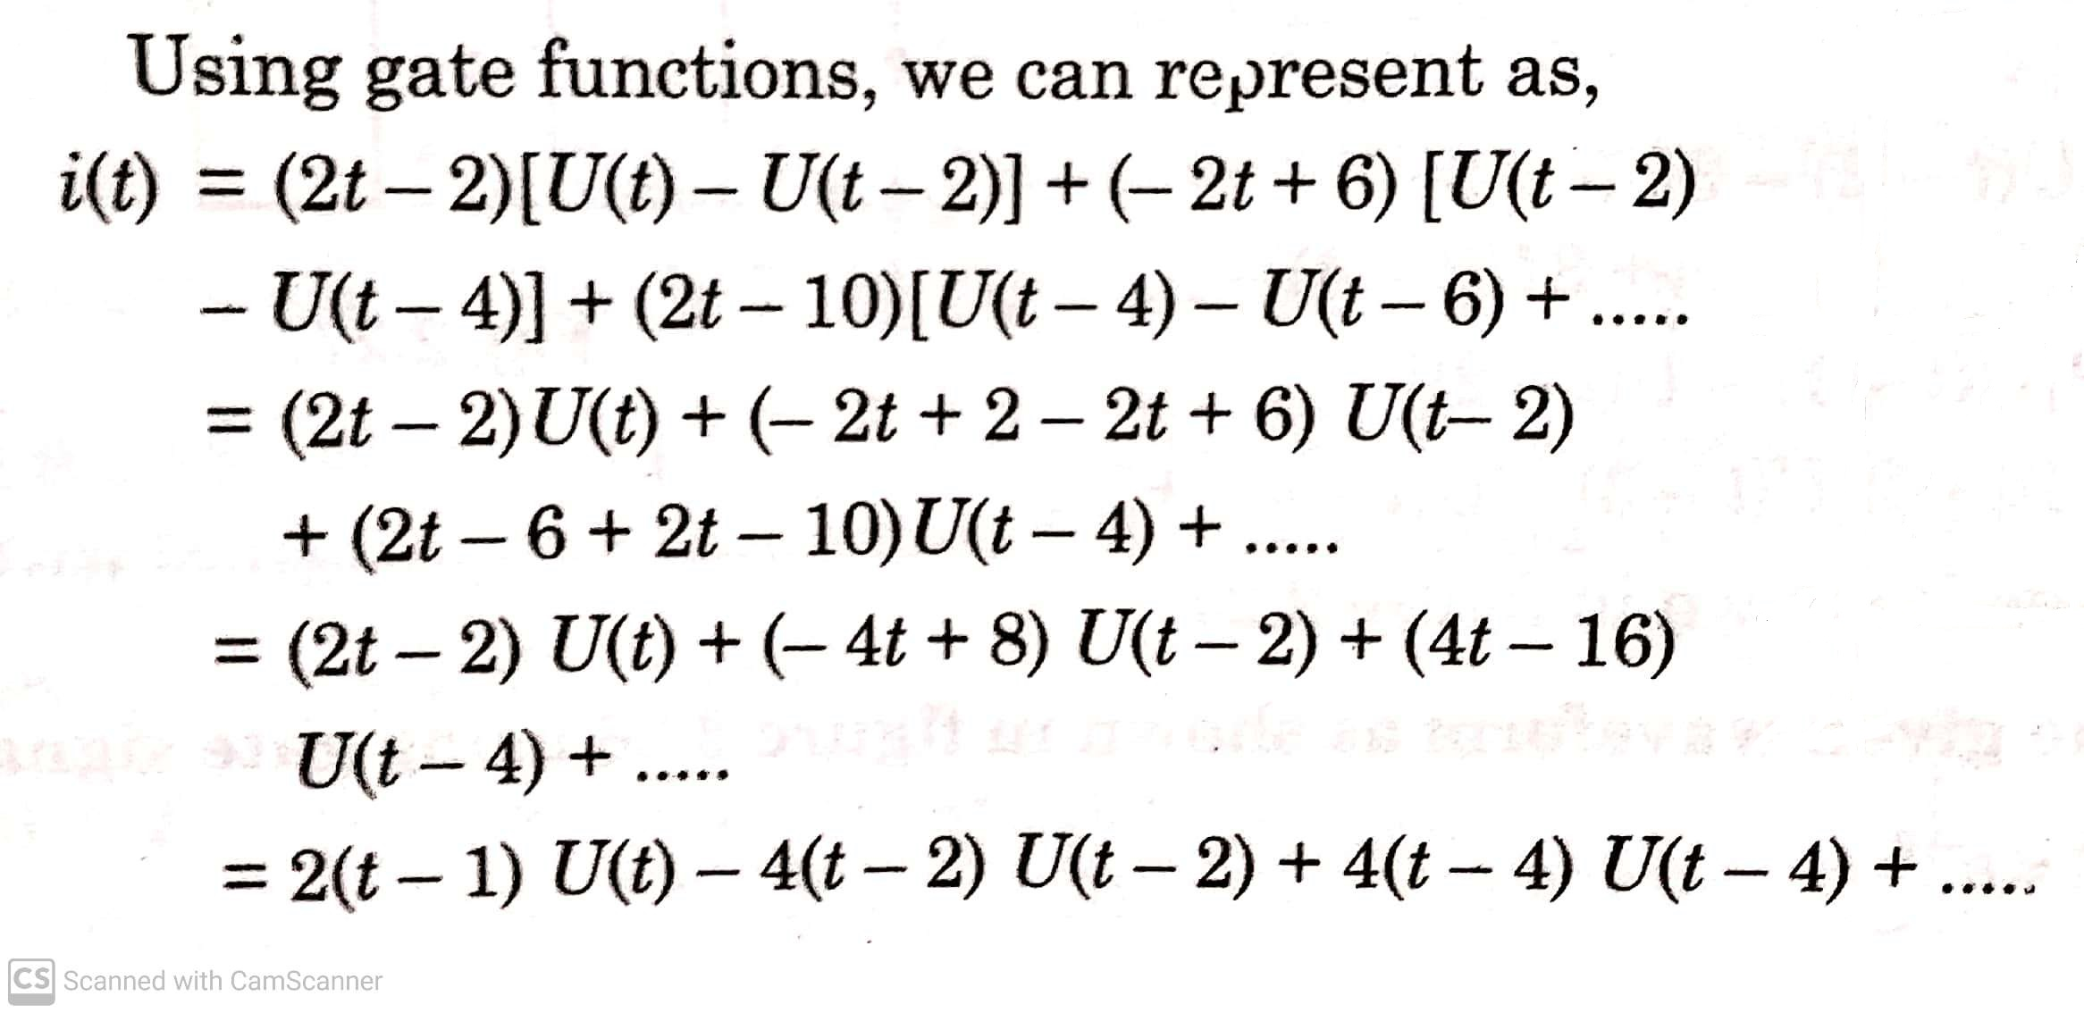
SOLUTION(5)

Slide 20
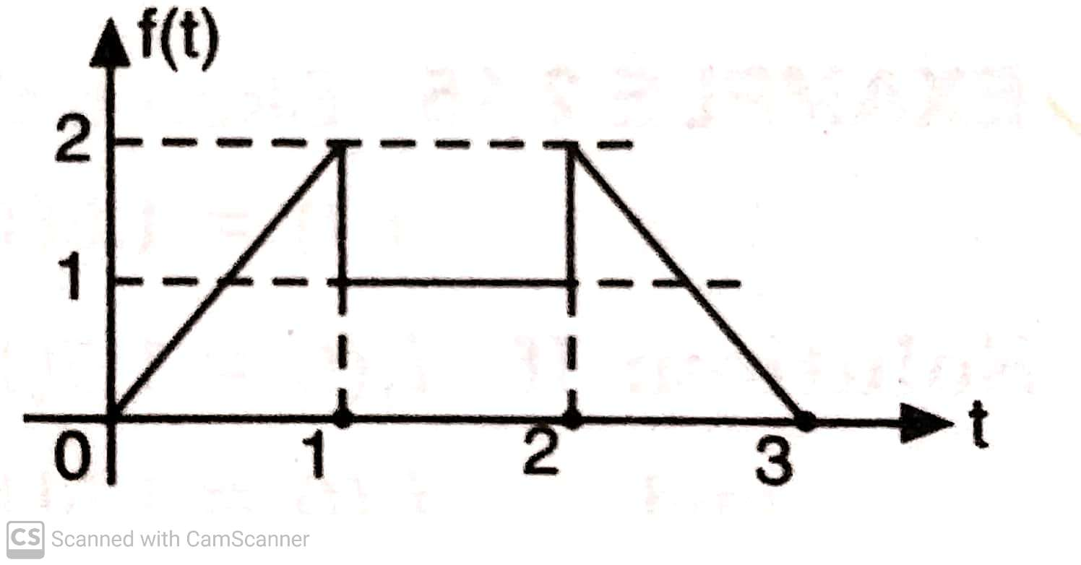
Q 6) Synthesize the given waveform shown in figure below:

Slide 21
SOLUTION(6)
Using the gate function, the given waveform can be synthesized as:
f(t) = 2t* G_{0,1}(t) + 1 * G_{1,2}(t) + (-2t+6) *G_{2,3}(t)
= 2t[U(t) – U(t-1)] + [U(t-1)- U(t-2)]
+ (-2t+6)[U(t-2)- U(t-3)]
= 2t U(t) – (2t-1) U(t-1) – (2t-5) U(t-2) + (2t-6) U(t-3)

Slide 22
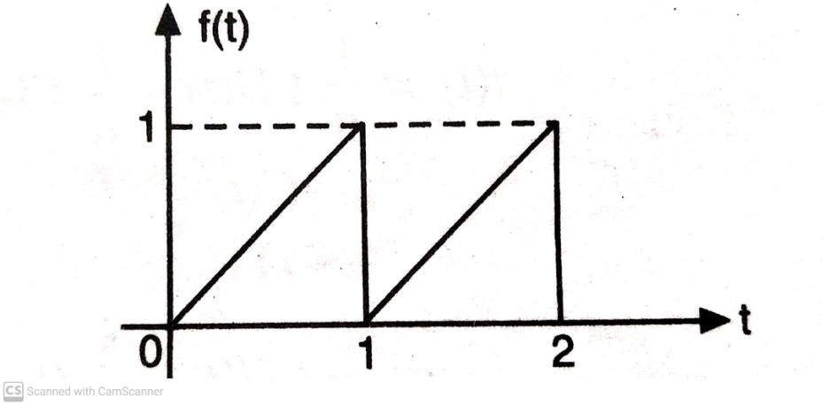
Q 7) Synthesize the given waveform shown in figure below:
SOLUTION(7):
Using gate functions;
f(t) = t [U(t)-U(t-1)] + (t-1) [U(t-1)- U(t-2)]
= t U(t) – t U(t-1) + (t-1) U(t-1) – (t-1) U(t-2)
= t U(t) – U(t-1) –(t-2+1) U(t-2)
= t U(t) – U(t-1) –(t-2) U(t-2) – U(t-2)
= r(t) – U(t-1) – r(t-2) – U(t-2)

Slide 23
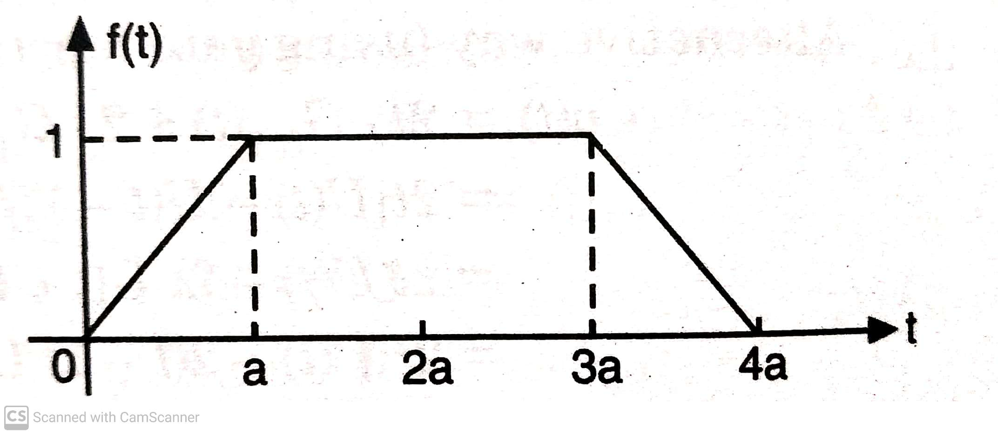
Q 8) Express the given waveform shown in figure below using both step & ramp signals.

Slide 24
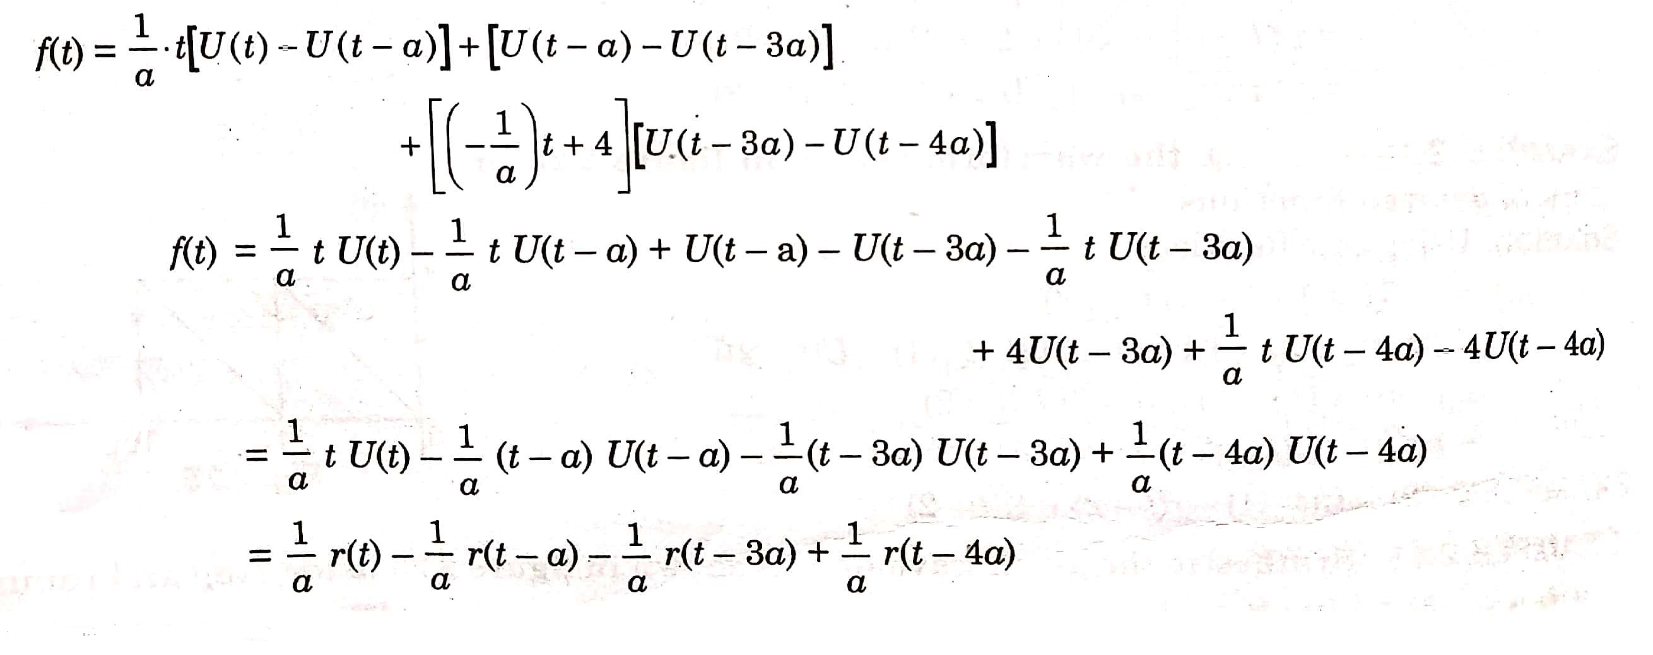
SOLUTION(8)

Slide 25
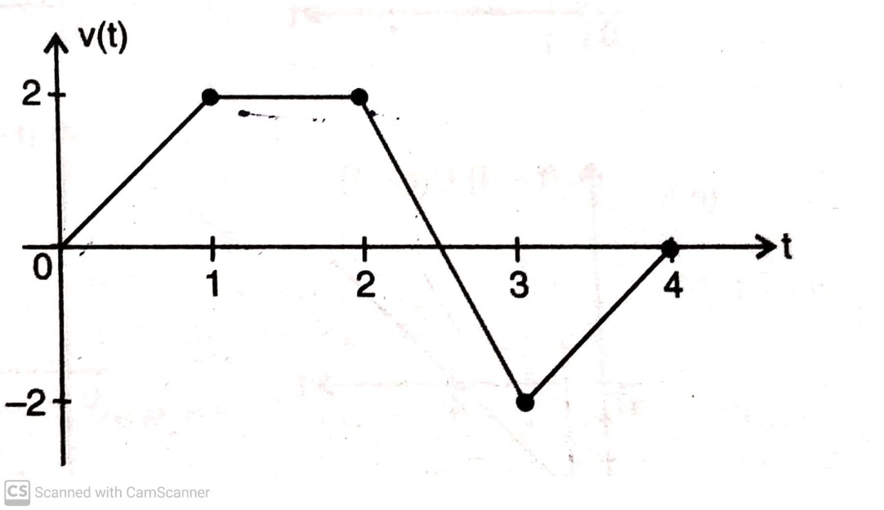
QUESTIONS FOR PRACTICE
Q 1) Express the given waveform shown in figure below using both step & ramp signals.
Ans: v(t) = 2tU(t) -2(t-1)U(t-1) – 4(t-2)U(t-2)
+ 6 (t- 3)U(t-3) – 2 (t-4) U(t-4)
= 2r(t) – 2r(t-1) – 4r(t-2) + 6r(t-3) – 2r(t-4)

Slide 26
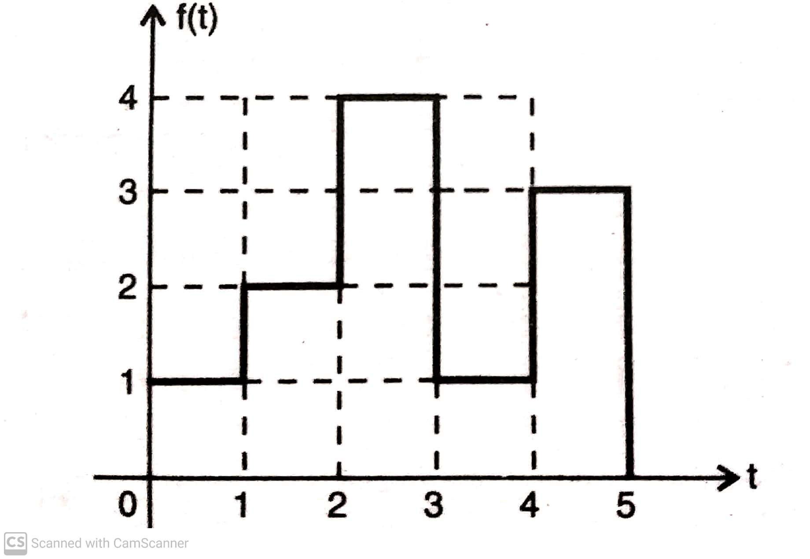
Q 2) Sketch the following signals:
U(t-5) – U(t-8)
U(t-6) + U(t-4)
t² [U(t-1)- U(t-3)]
Q 3) Synthesize the given waveforms using standard signals:
(i)

Slide 27
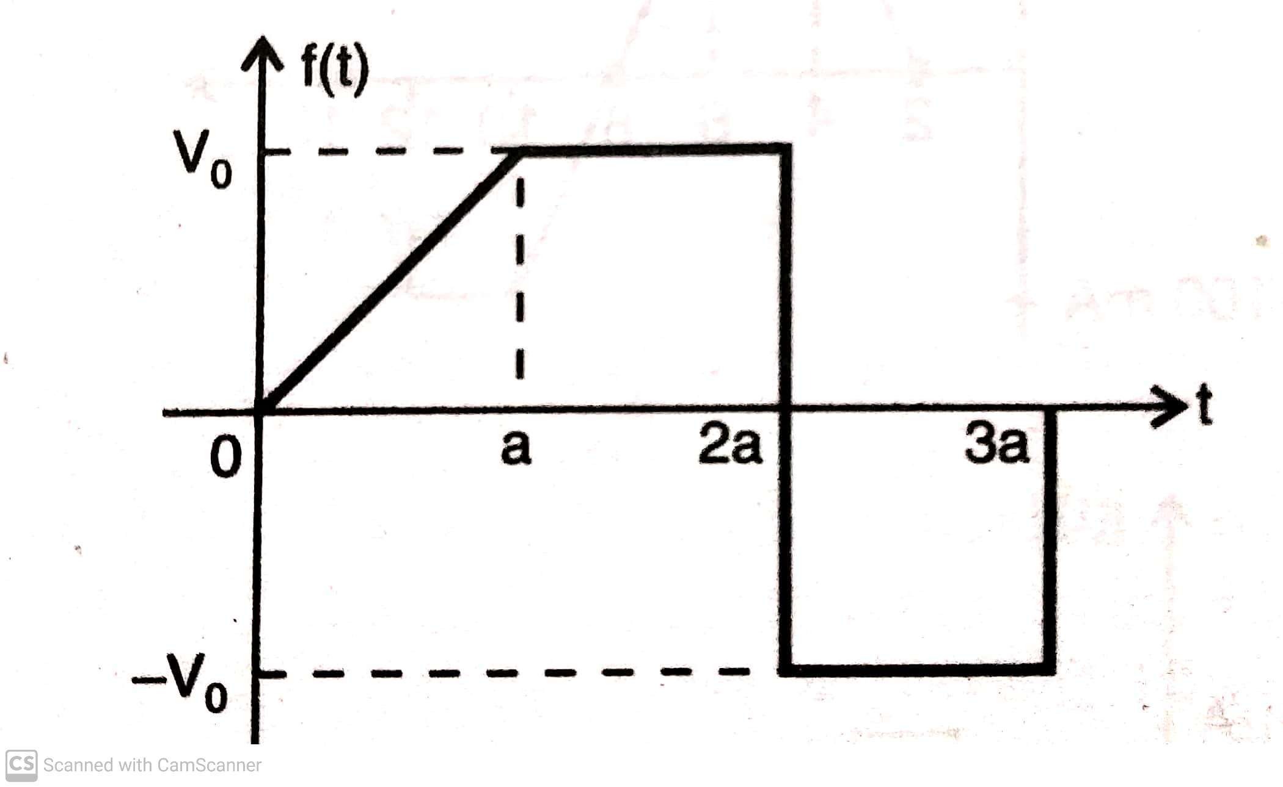
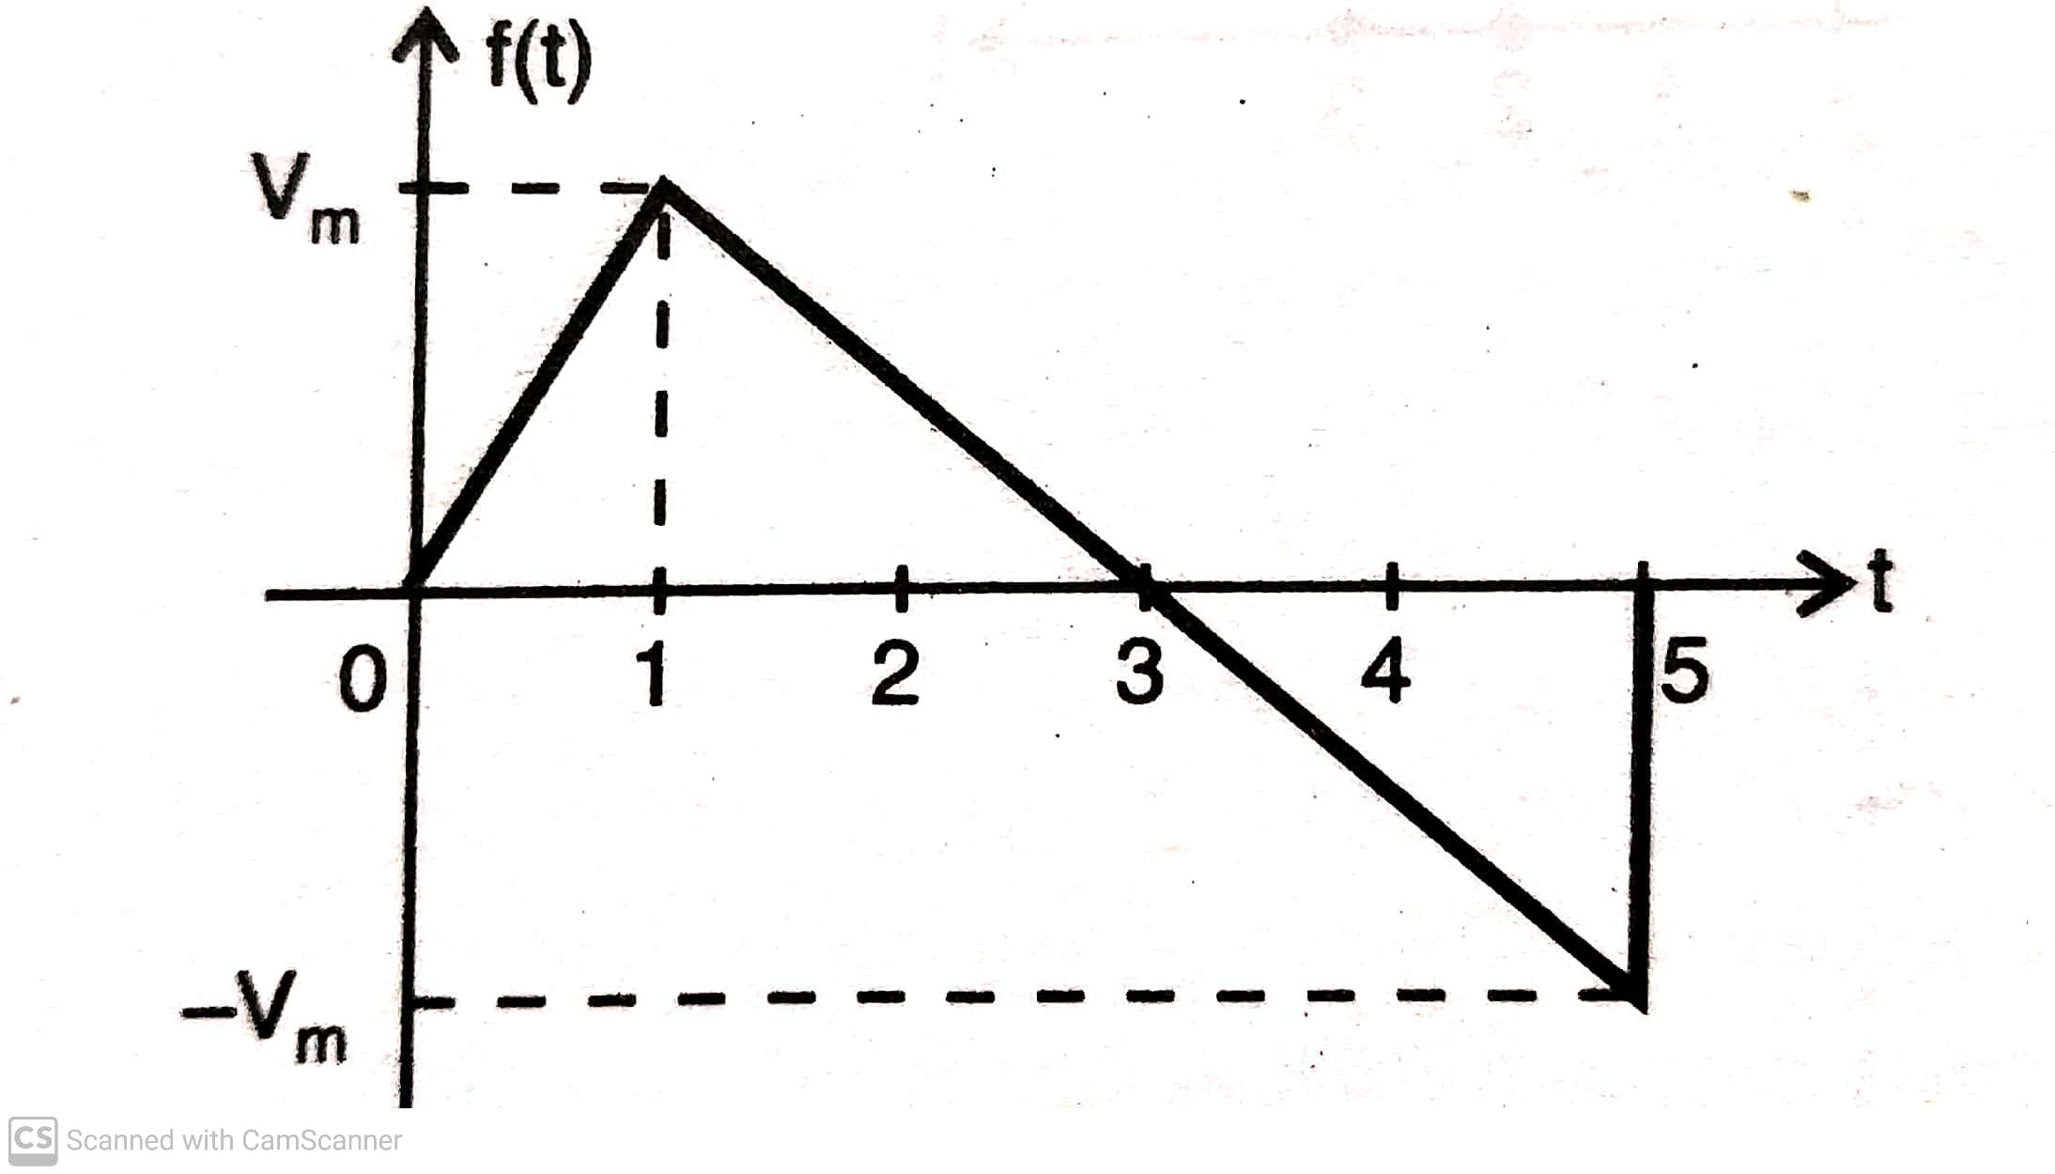
(ii)
(iii)

Slide 28
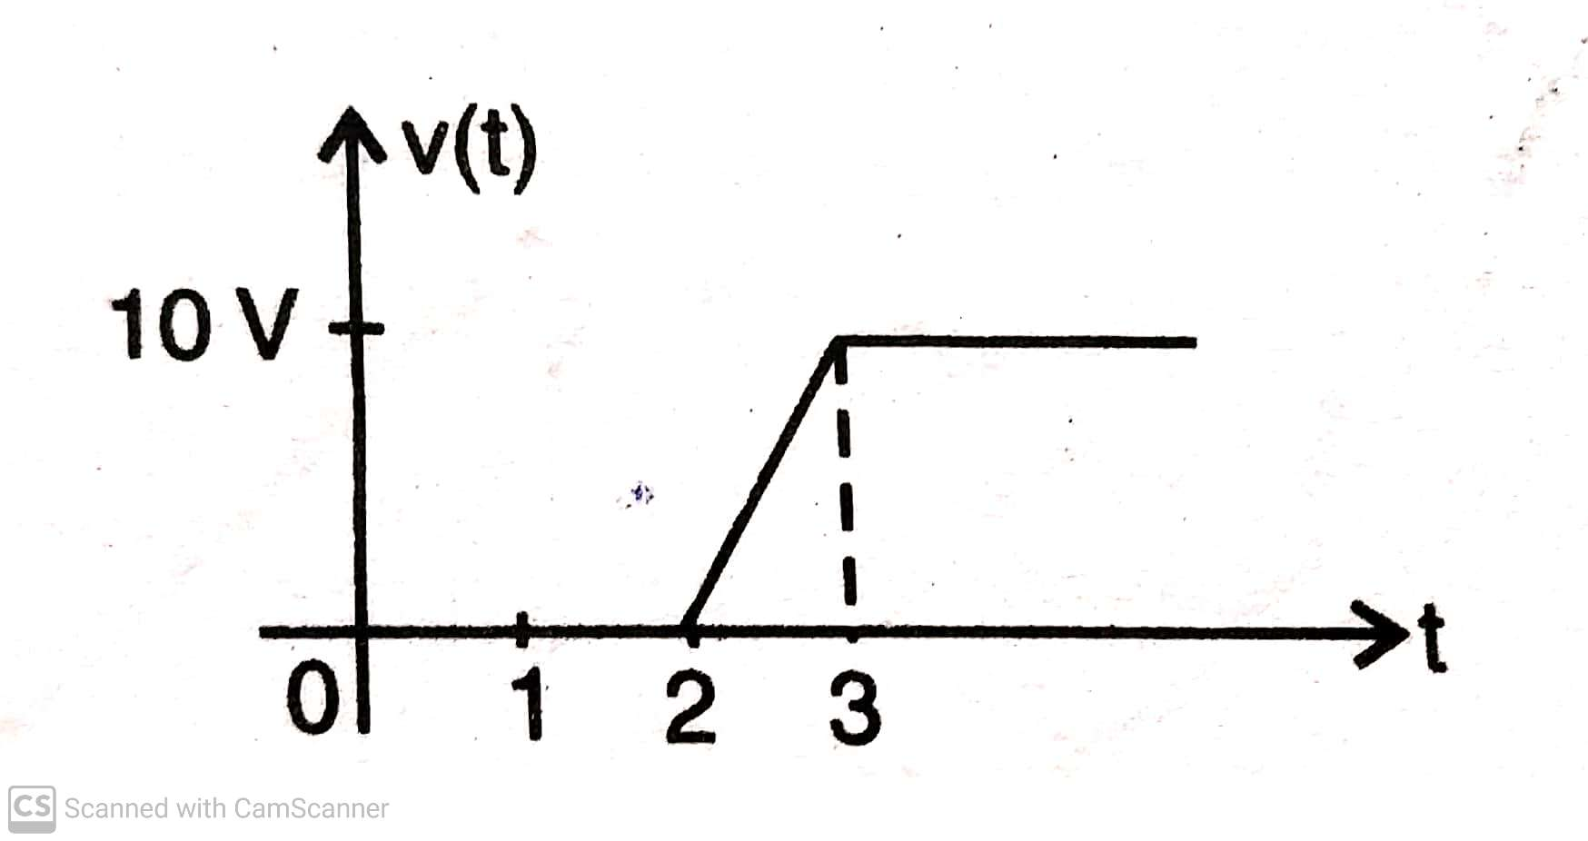
Ans(3) :
f(t) = U(t)+ U(t-1) + 2U(t-2) – 3U(t-3) + 2U(t-4)
– 3U(t-5)
f(t) = V₀/a[r(t) – r(t-a)] – 2 V₀ U(t-2a) + V₀ U(t-3a)
f(t) = Vm r(t) – 1.5 Vm r(t-1) + 0.5 Vm r(t-5)
+ Vm U(t-5)
Q4) The voltage waveform across the capacitor 0.2μF is shown in fig below. Determine the current waveform through it.

Slide 29
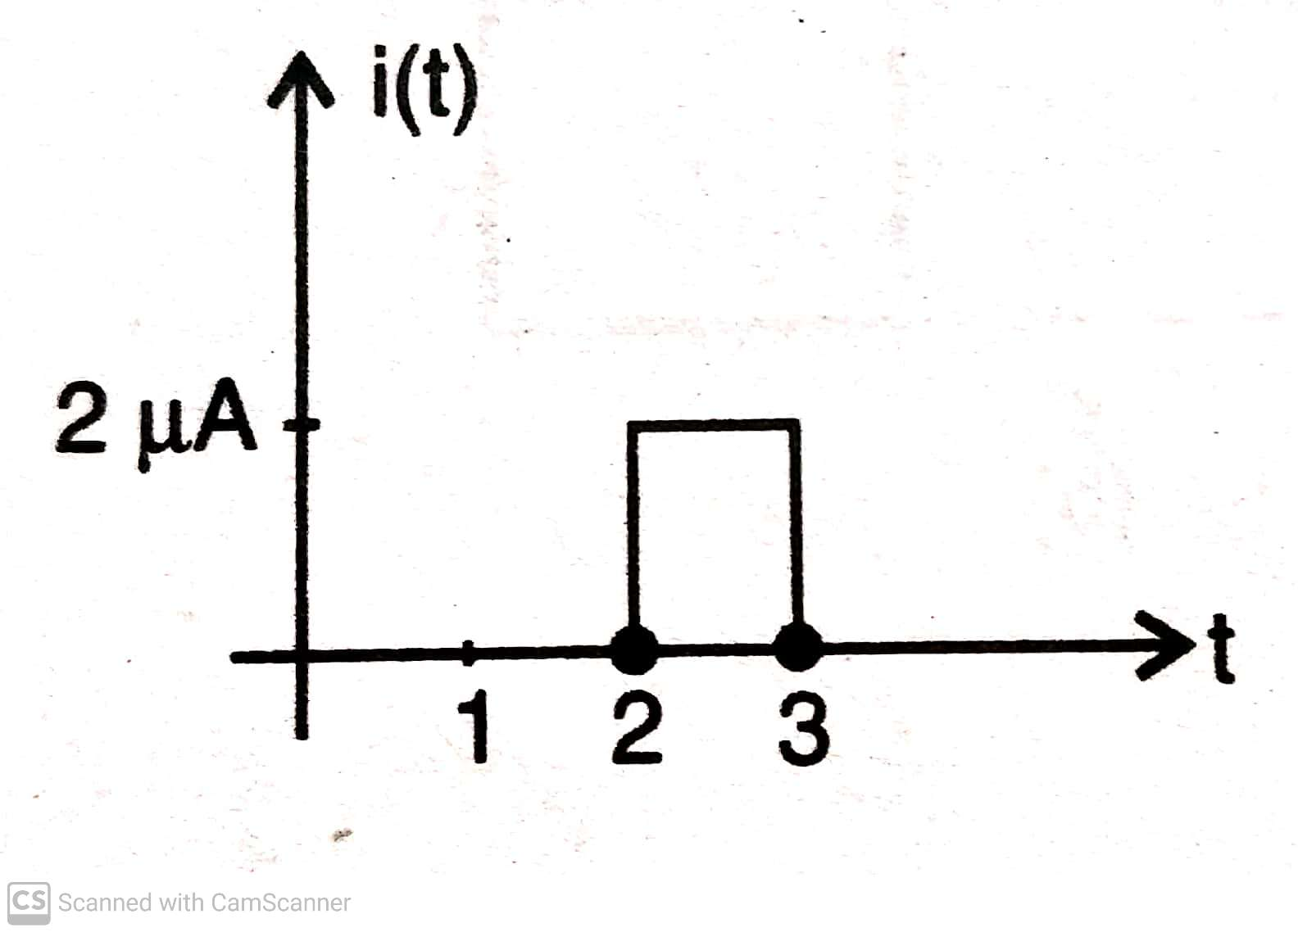
Ans(4):

